Slide 1
Data Structures Algorithm and Design SSZG519
Mr. Chennupati R Prasanna

Slide 2
SSZG519-Asymptotic analysis [General rules and Problem]

Slide 3
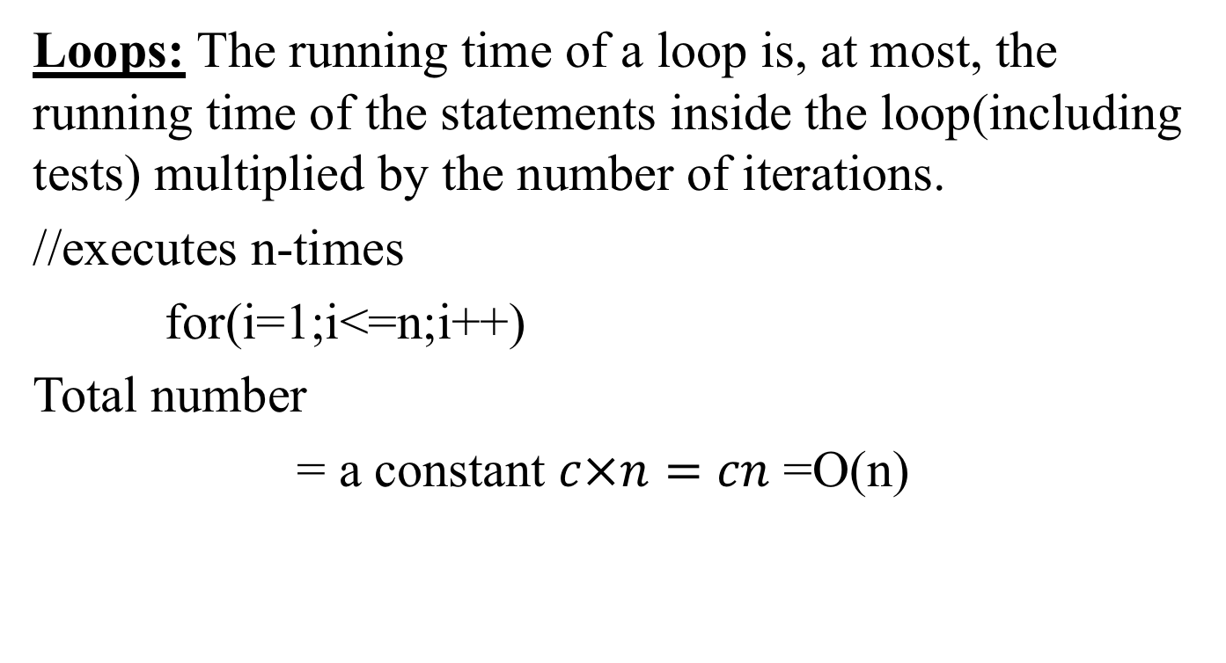
General rules to determine running time of algorithm
Loops: The running time of a loop is, at most, the running time of the statements inside the loop(including tests) multiplied by the number of iterations.
//executes n-times
for(i=1;i<=n;i++)
Total number
= a constant $c×n=cn$ =O(n)

Slide 4
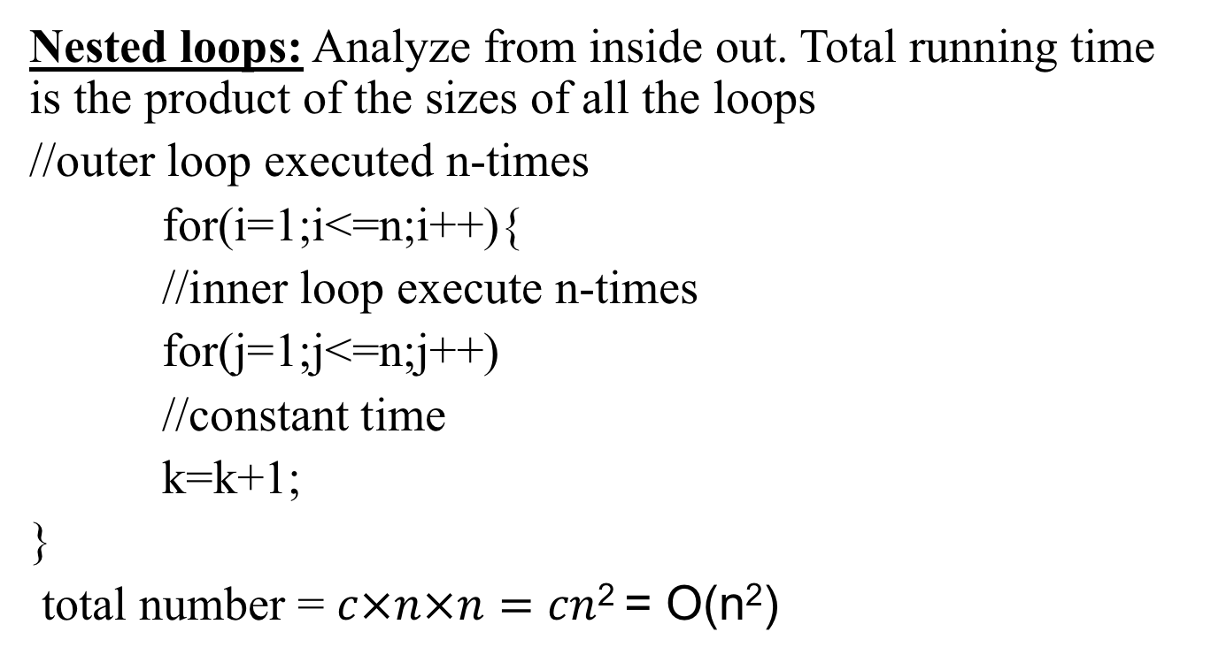
General rules to determine running time of algorithm (Cont..,)
Nested loops: Analyze from inside out. Total running time is the product of the sizes of all the loops
//outer loop executed n-times
for(i=1;i<=n;i++){
//inner loop execute n-times
for(j=1;j<=n;j++)
//constant time
k=k+1;
}
total number = $c×n×n=cn$² = O(n²)

Slide 5
General rules to determine running time of algorithm (Cont..,)
Consecutive statements: Add the time complexities of each statement.
//constant time
x=x+1;
//executed n-times
for(i=1;i<=n;i++)
//constant time
m=m+2;
//outer loop executed n-times
for(i=1;i<=n;i++){
//inner loop executed n-times
for(j=1;j<=n;j++)
//constant time
k= k+1;
}
Total time = c₀ + c₁n + c₂n² = O(n²)

Slide 6
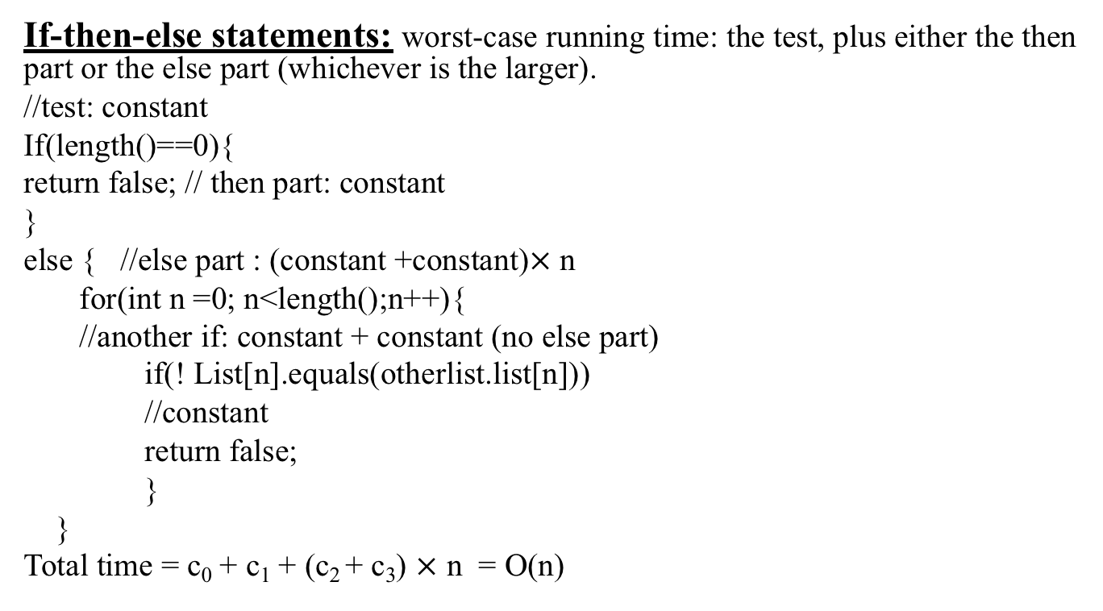
General rules to determine running time of algorithm (Cont..,)
If-then-else statements: worst-case running time: the test, plus either the then part or the else part (whichever is the larger).
//test: constant
If(length()==0){
return false; // then part: constant
}
else { //else part : (constant +constant)$×$ n
for(int n =0; n<length();n++){
//another if: constant + constant (no else part)
if(! List[n].equals(otherlist.list[n]))
//constant
return false;
}
}
Total time = c₀ + c₁ + (c₂ + c₃) $×$ n = O(n)

Slide 7
General rules to determine running time of algorithm (Cont..,)
Logarithmic complexity: an algorithm is O(logn) if it takes constant time to cut the problem size by a fraction (usually by ½)
As an example let us consider the following program
for(i=1; i<=n;)
i=i*2;
If we observe carefully, the value of i is doubling every time initially i=1, in next step i=2, and in subsequent steps i = 4,8 and soon.
Let us assume that the loop is executing some k-times.
At k^{th} step 2^{k}=n and we come out of loop
Taking logarithm on both sides, gives
log(2^{k}) = log n
klog2 = log n
k = log n // if we assume base ~ 2.
Total number = O(logn)

Slide 8
Problem-1
What is the complexity of the program given below
void function (int n){
//outer loop executes n/2- times
for (i =n/2; i<=n; i++)
//middle loop executes n/2
for (j=1;j+n/2<=n;j=j++)
//loop execute logn times
for (k=1;k<=n;k=k*2)
count++;
}
Time complexity of the above function is O(n²logn)

Slide 9
Problem-3
function (int n){
//constant time
if(n==1) return;
//outer loop execute n times
for (int i =1;i<=n;i++){
// inner loop executes only time due to break statement
for (int j =1;j<=n;j++){
printf(“*”);
break;
}
}
}
Time complexity of the above function is?

Slide 10
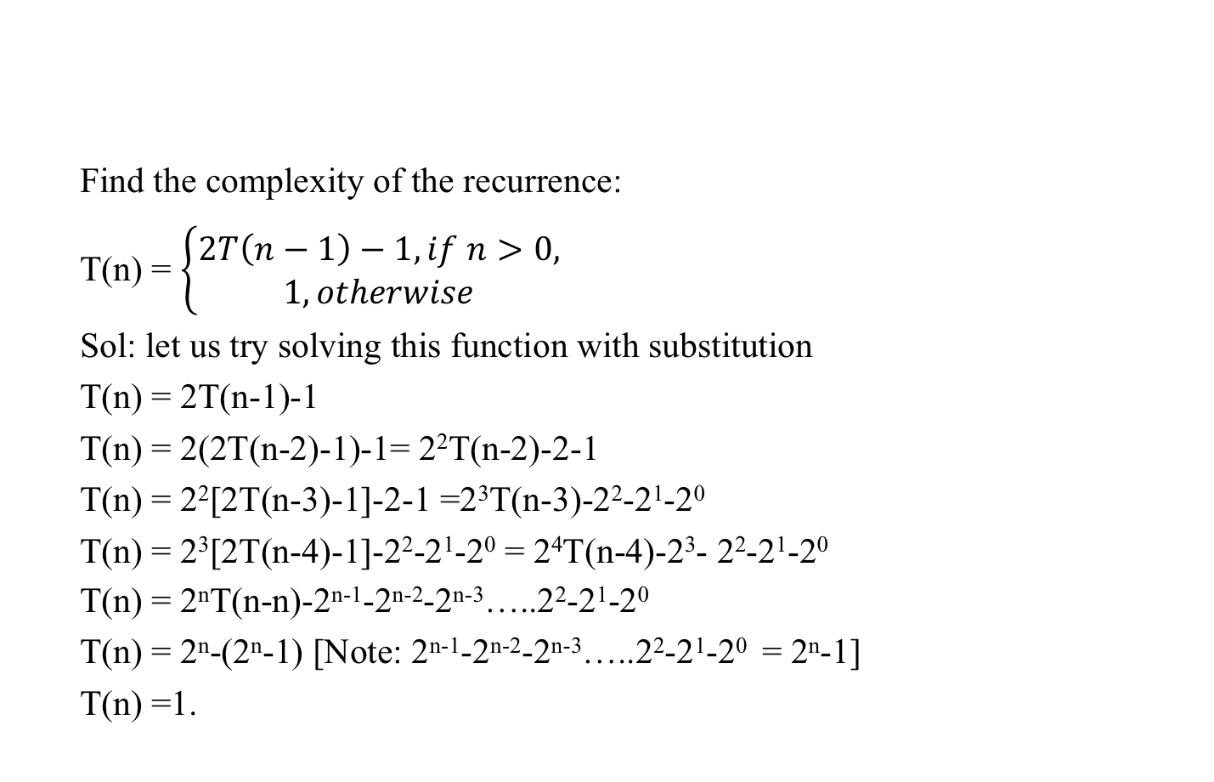
Problem 4
Find the complexity of the recurrence:
T(n) = $\left\{\begin{aligned}2T\left(n−1\right)−1, if n>0, \\ 1, otherwise\end{aligned}\right.$
Sol: let us try solving this function with substitution
T(n) = 2T(n-1)-1
T(n) = 2(2T(n-2)-1)-1= 2²T(n-2)-2-1
T(n) = 2²[2T(n-3)-1]-2-1 =2³T(n-3)-2²-2¹-2⁰
T(n) = 2³[2T(n-4)-1]-2²-2¹-2⁰ = 2⁴T(n-4)-2³- 2²-2¹-2⁰
T(n) = 2^{n}T(n-n)-2^{n-1}-2^{n-2}-2^{n-3}…..2²-2¹-2⁰
T(n) = 2^{n}-(2^{n}-1) [Note: 2^{n-1}-2^{n-2}-2^{n-3}…..2²-2¹-2⁰ = 2^{n}-1]
T(n) =1.

Slide 11
Master Methods
Explain the master Method
A utility method for analysis recurrence relations
Useful in many cases for divide and conquer algorithms.
These recurrence relations are of the forms:
T(n) = aT(n/b)+f(n) where a> = 1, b>1
n = the size of the current problem
a = the number of sub-problems in the recursion.
n/b = the size of each subproblem
f(n) = the cost of work that has to de done outside the recursive calls (Cost of dividing + merging).

Slide 12
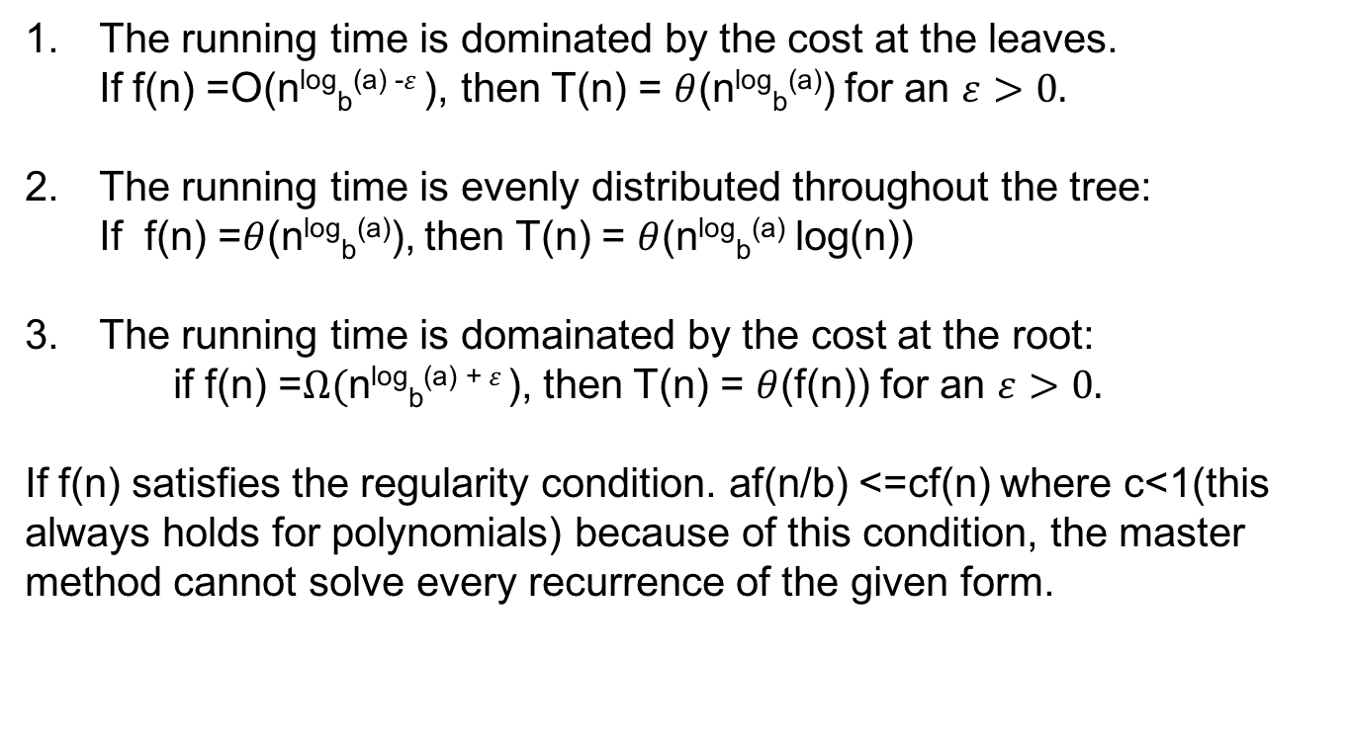
Master Theorem case

Slide 13
How to apply the master method(step by step)
Extract a,b and f(n) form a given recurrence
Determine n^{log}_{b}ª
Compare f(n) and n^{log}_{b}ª asymptotically.
Determine the appropriate Master method case and apply it

Slide 14
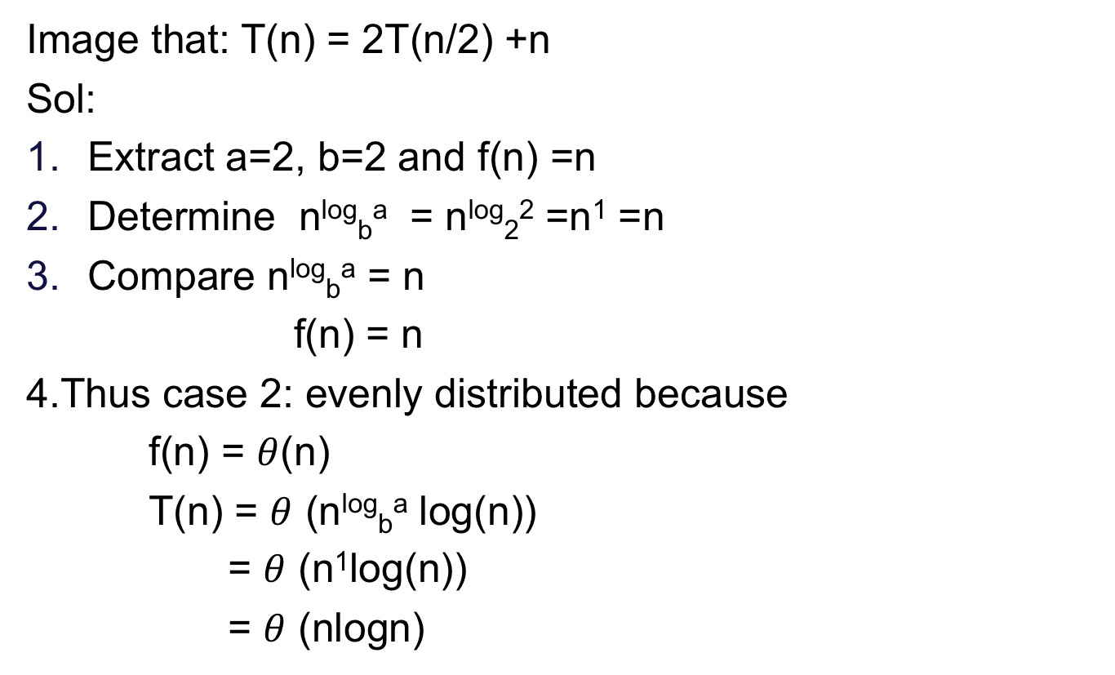
For each case an exercise[Ex:-1]
Image that: T(n) = 2T(n/2) +n
Sol:
Extract a=2, b=2 and f(n) =n
Determine n^{log}_{b}ª = n^{log}₂² =n¹ =n
Compare n^{log}_{b}ª = n
f(n) = n
4.Thus case 2: evenly distributed because
f(n) = $θ$(n)
T(n) = $θ$ (n^{log}_{b}ª log(n))
= $θ$ (n¹log(n))
= $θ$ (nlogn)

Slide 15
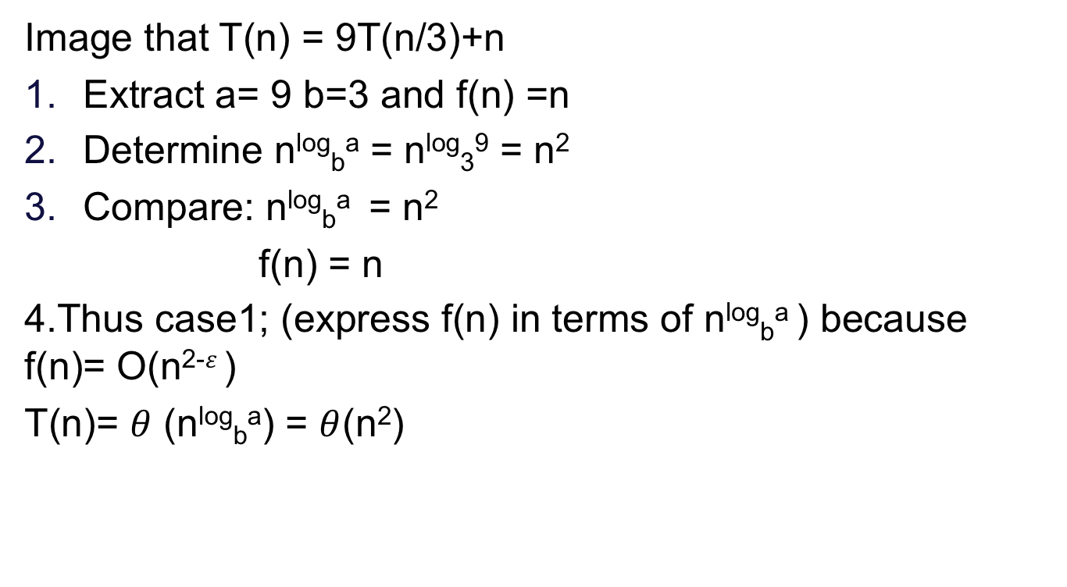
Example: 2
Image that T(n) = 9T(n/3)+n
Extract a= 9 b=3 and f(n) =n
Determine n^{log}_{b}ª = n^{log}₃⁹ = n²
Compare: n^{log}_{b}ª = n²
f(n) = n
4.Thus case1; (express f(n) in terms of n^{log}_{b}ª ) because f(n)= O(n²⁻$ε$)
T(n)= $θ$ (n^{log}_{b}ª) = $θ$(n²)

Slide 16
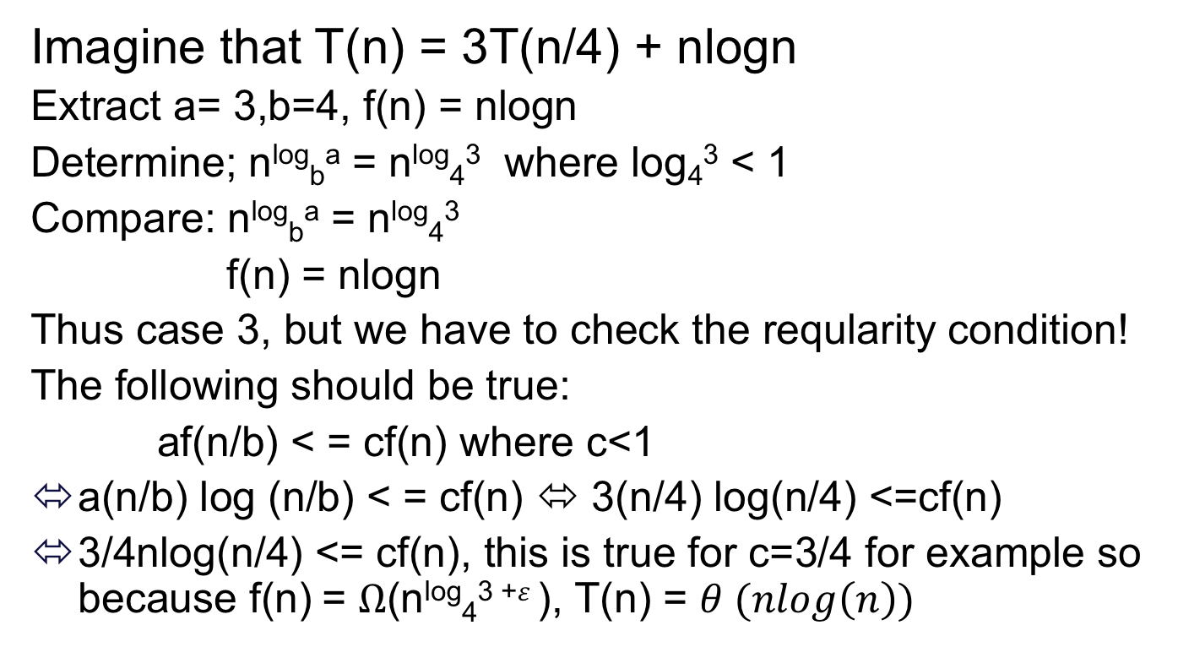
Example: 3
Imagine that T(n) = 3T(n/4) + nlogn
Extract a= 3,b=4, f(n) = nlogn
Determine; n^{log}_{b}ª = n^{log}₄³ where log₄³ < 1
Compare: n^{log}_{b}ª = n^{log}₄³
f(n) = nlogn
Thus case 3, but we have to check the reqularity condition!
The following should be true:
af(n/b) < = cf(n) where c<1
a(n/b) log (n/b) < = cf(n) ⬄ 3(n/4) log(n/4) <=cf(n)
3/4nlog(n/4) <= cf(n), this is true for c=3/4 for example so because f(n) = $Ω$(n^{log}₄³ ⁺$ε$), T(n) = $θ (nlog\left(n\right))$

Slide 17
Thank You!!

